Slide 1
KPU: Bachelors of Business Administration
Budgeting 101

Slide 2
Tuition/Student Fees
Tuition fees
The cost for taking 24 credits: $3540.00
Student fees
University Levied Student Fees: $247.68
Kwantlen Student Association Fees: $222.25
KSA Extended Health Plan: $87.55 per year
KSA Dental Plan: $113.30 per year
Total- $670.78 per year

Slide 3
Books & Supplies
Books & Supplies: $1200 per year
How can we save money on books?
By buying used books.
Check out the price of e-books.
Rent your textbooks online.
Buying the older edition.
Try finding in the library.
Using your high school/old supplies in the university for example binders, markers, calculators, etc.

Slide 4
Books & Supplies
Where to find books?
Books2go (https://www.books2go.ca/)
KPU Bookstore
Amazon (https://www.amazon.ca/)
Facebook(Marketplace)

Slide 5
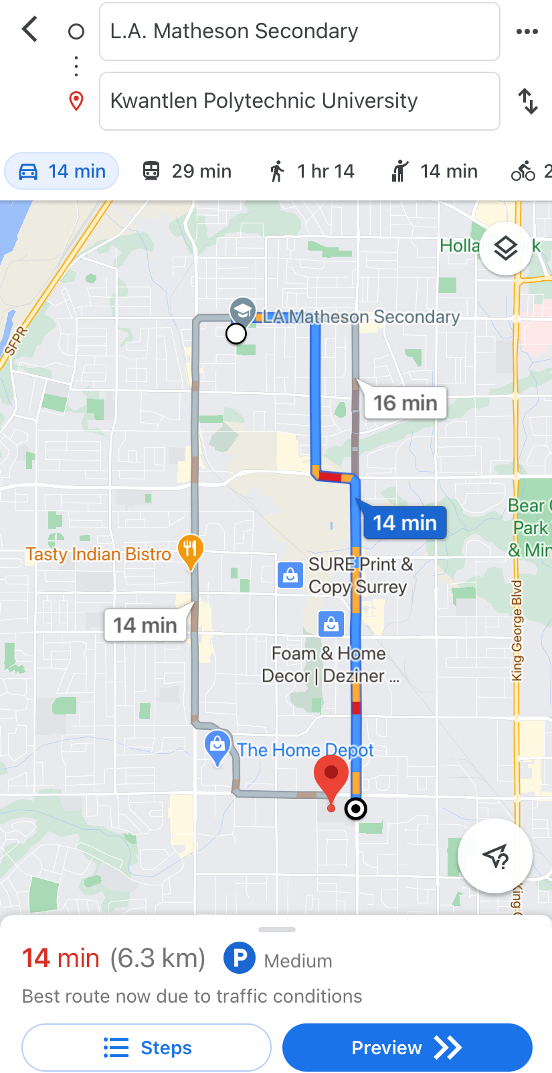
Transportation
Multi-Pass: $52.50 per month; $420 per year
Driving
Time required to get to KPU Surrey Campus: 14 minutes
Gas: $40 biweekly; $640 per year
Parking: Excluded (parking is currently free because of COVID-19)
Otherwise it’s $190 per semester.

Slide 6
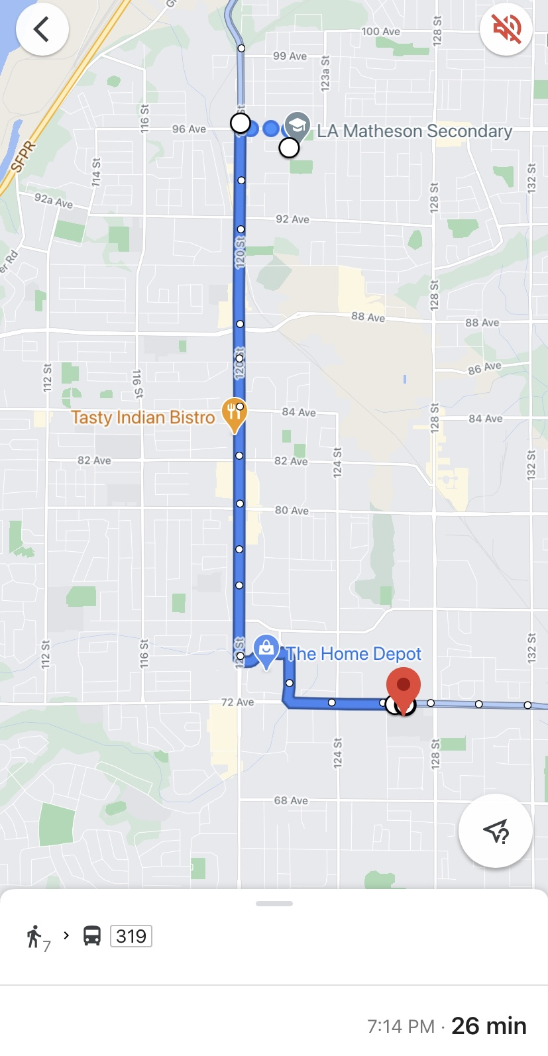
Transportation
In Transit:
Time required to get to KPU Surrey Campus: 26minutes
Walk to 96 Ave, Scott Road (7 min)
Board the 319 bus Newton Exchange
Exit bus at 76 Ave,128 St
Walk to KPU (2 min)

Slide 7
Housing
Living with Parents: It depends upon everyone’s personal choice, decision and convenience.
Living On-Campus: KPU doesn’t have school housing/dorms.
Living Off- Campus:
Renting out 2 bedroom basement/condo: $1100- $1500 per month
Renting out 1 bedroom basement: $700- $1000 per month
Features: Air conditioner, refrigerator, laundry (twice a week), internet (maybe), furnished (depending upon your choice), etc.
Find a place near your campus and any other place which will be convenient to you.
Utilities must include: Heat, water and electricity.

Slide 8
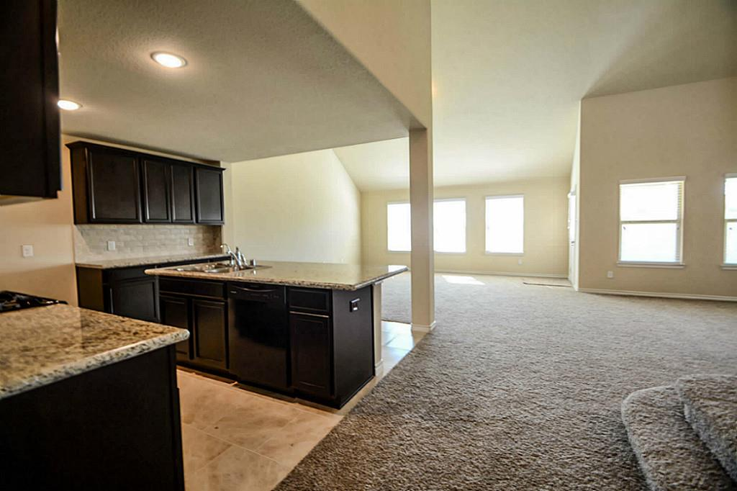
Housing
Where to search for off- campus housing places?
https://www.search4studenthousing.com/
https://vancouver.craigslist.org/rds/
https://www.kijiji.ca/h-british-columbia/9007
https://www.zoeken.ca/rent/basement/surrey+bc/all/
https://www.places4students.com/

Slide 9
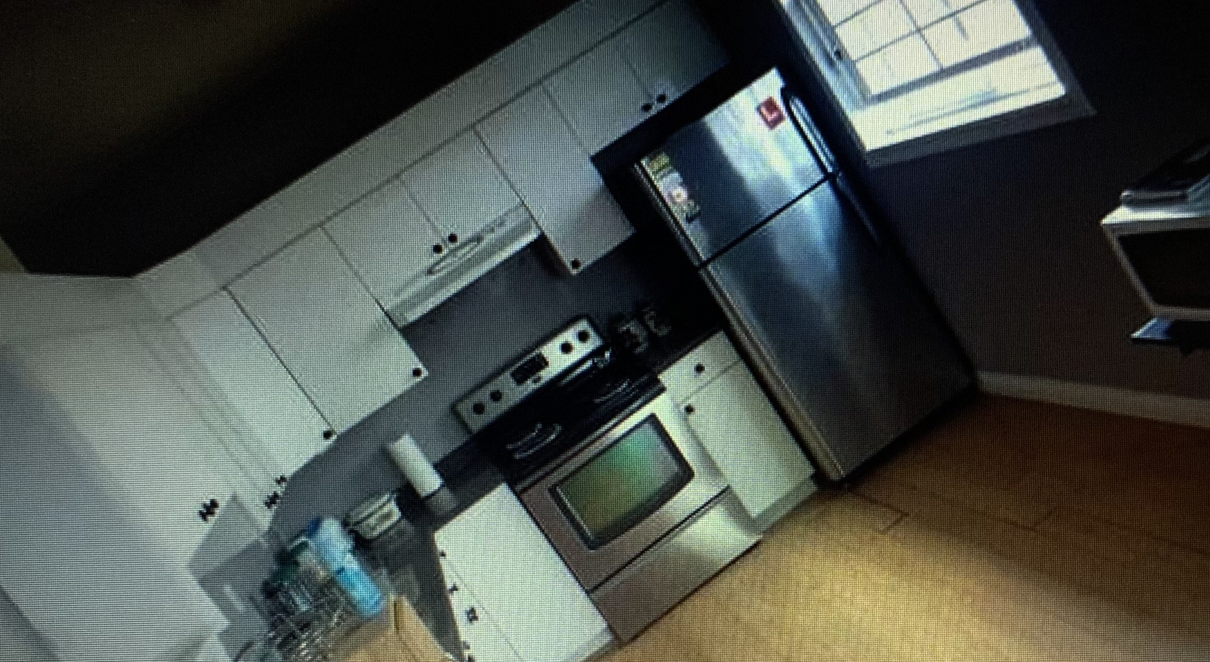
Housing
An off-campus housing place that I had found near my campus is:-
Rent- $975 per month
Cable and Wi-Fi Included.
Utilities included- Hydro and electricity(heat)
Area – Next to Amrit Prakash temple, close to the fruiticana store.
No laundry
https://vancouver.craigslist.org/rds/apa/d/surrey-upper-west-one-bedroom-bsmnt-for/7209333042.html

Slide 10
Food
At home (living with parents)
Eating out or order online: $35 per week; $1,680 per year
Living off-campus (living without parents)
Grocery/ Eating out/ Order online: $350 per month
$4,200 per year

Slide 11
Special Cost/ Moving Cost
Special Cost
Laptop: HP Silver Intel Core i7 (15.6 inch) - $899.00
Cell phone: $50 per month; $600 per year
Moving Cost
U-Haul truck: $39.95 per day
Mattress: $350
Desk and Chair: $250
Carpet: $150
Queen Bed: $300

Slide 12
Totals
Yearly Cost | Student living at home | Students living in the community
Tuition Fees | $3540.00 | $3540.00
Books/Supplies | $1200.00 | $1200.00
Student Fees | $670.78 | $670.78
Transportation | $640.00 | $640.00
Housing | $0 | $6400- $8800
Food | $1680.00 | $4200.00
Special Cost | $1499.00 | $1499.00
Moving Cost | $0 | $1089.95
Total | $9229.78 | $19239.73 - $21639.73

Slide 13
By: Yashika Mahajan

